Slide 1
VBA for Excel
Ecole de Management Leonard de Vinci
Session 3
Achraf Seddik
seddik.achraf.1@gmail.com

Slide 2
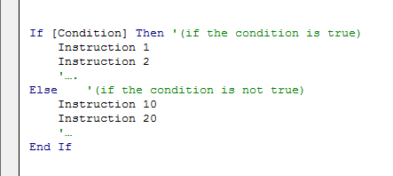
Recall - conditional tests : If function
Conditions are very useful in programming, they will enable us to carry out actions according to some precise criteria.
The main conditional tests function in VBA is “If” function (same principle as “if” function in excel), here is its syntax (simple if):
If the condition (or test) is true then the program executes instructions 1 and 2 (then), otherwise it executes instructions 10 and 20 (else).

Slide 3
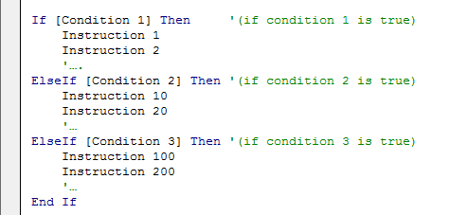
Recall - Conditional tests : Multiple If
It is possible to use multiple “if” functions :
If the condition1 is not true then the program checks condition 2, if it is not true, it checks condition 3, if it is true (then) it executes instructions 100 and 200.

Slide 4
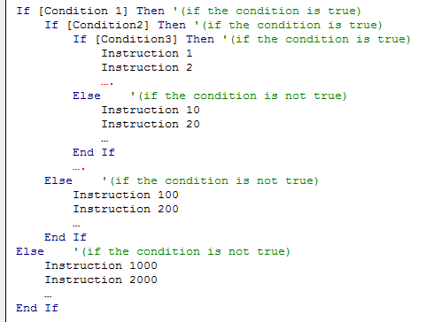
Recall - Conditional tests : Nested if functions
It is possible to imbricate (nest) “if” functions in each others :
Instructions 1 and 2 are executed when conditions 1, 2 and 3 are True
Instructions 10 and 20are executed when conditions 1, 2 are True but condition 3 is False
Instructions 100 and 200 are executed when conditions 1 is True but condition 2 is False

Slide 5
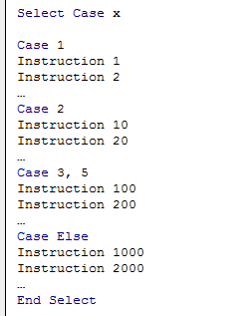
Recall - Conditional tests : Case test
Syntax :
If the condition in case 1 is true then the (then) instructions 1 and 2 are executed etc.

Slide 6
Lesson 3 Repetitive structures and loops

Slide 7
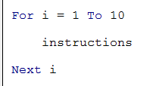
Loops (For, Do)
In programming it is often necessary to repeat the execution of tasks. To do so we use repetitive structures often called "Loops".
Lesson Objectives :
Mastering repetitive Structures like the “For” Loop, “Do While” loop or “Do Until” loop.
For loop : Syntax example :
This loop allows to repeat the instructions between the For (start of the loop) and the Next (end of loop).
“i” is the loop variable; we define its start value (here equal to 1) and its end value (here equal to 10). With each passage on the instruction
“Next i”, the variable i is incremented by one unit and the program goes back to the beginning of the loop. So here will “pass” ten times in this loop.

Slide 8
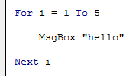

For loops
Example 1 :
Example 2 :
This loop displays in a message box “hello” 5 times
This loop displays 3 then 2 then 1. “step -1” means that the loop is decremented by a unit

Slide 9
Do… Loops (loop with condition)
Do … Loop While
Do … Loop Until :
Repeat the instructions while the condition is verified
Repeat the instructions until the condition is verified

Slide 10
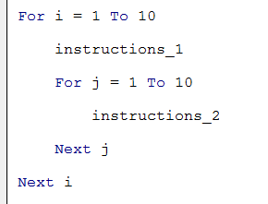
Imbricated for loops
Example :
Repeat “instructions_1” i times
“Instructions_2” are run j times for the first value of i
“instructions_2” are then repeated i x j times

Slide 11
Applications Exercice Sheet N°3

Slide 12
Appendix.
1. VBA variables types
2. Operators
Arithmetic | ^ | - [negation] | * | / | + | & | Mod
Comparaison | = | <> [different] | < | > | <= | >= | Like | Is
Logical | Not | And | Or | Xor | Eqv | Imp

